Slide 1

HVEC Implementation
Kyle Swartz Chandi Gastali
Vicente Alsidez-Longoria Melvin Padolina
Notes:
Vicente open

Slide 2
Project charter and SCOPE/stakeholders
Objective: Develop and implement a data analytics dashboard to provide functional analysis. Project scope: High voltage’s development team will create and implement a data analytics dashboard that provides field measurements, weather forecasting, predicative analytics, security and access control along with revenue and production cost. Stakeholders: Data analytics team, IT development team, Marketing teams and engineers. Implementation: Start date: 01/11/2024 Duration: 10 months
Notes:
Vicente
OBJECTIVE: DEVELOP AND IMPLEMENT A DATA ANALYTICS DASHBOARD TO PROVIDE FUNCTIONAL ANALYSIS. PROJECT SCOPE: HIGH VOLTAGE’S DEVELOPMENT TEAM WILL CREATE AND IMPLEMENT A DATA ANALYTICS DASHBOARD THAT PROVIDES:
FIELD MEASUREMENTS: Display real-time data on energy production, consumption, and distribution.
WEATHER FORECASTING: Integrate weather data to assess its impact on energy consumption and production.
PREDICATIVE ANALYTICS: Implement predictive modeling to forecast energy demand, equipment failures, and potential grid issues.
SECURITY AND ACCESS CONTROL : Implement robust security measures to protect sensitive data.
ALONG WITH REVENUE AND PRODUCTION COST : · Breakdown consumption by residential, commercial, and industrial sectors. STAKEHOLDERS: DATA ANALYTICS TEAM, IT DEVELOPMENT TEAM, MARKETING TEAMS AND ENGINEERS.
IMPLEMENTATION:
START DATE: 01/11/2024
DURATION: 10 MONTHS

Slide 3
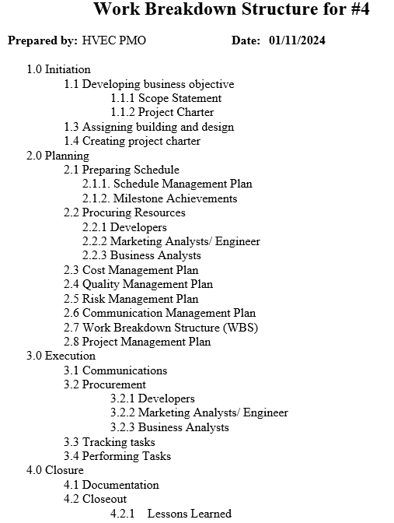
Work breakdown structure
Notes:
Melvin

Slide 4
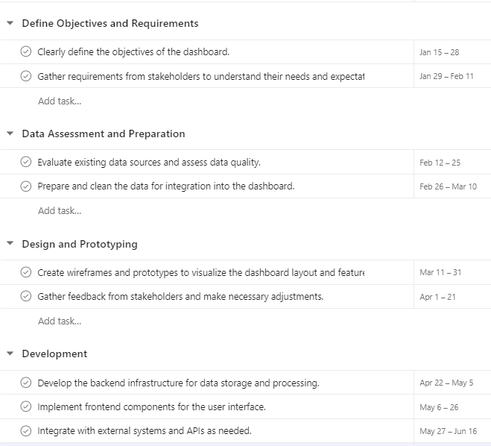
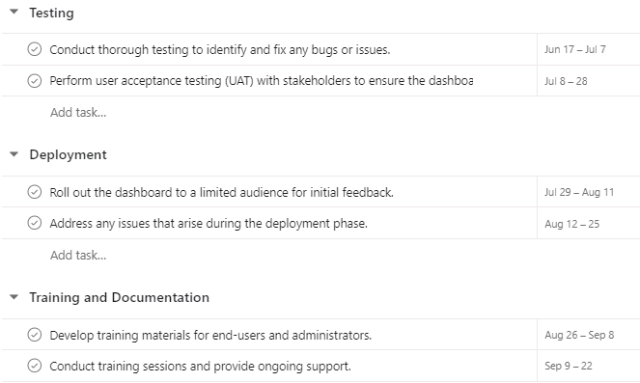
Schedule Management plan
Notes:
Kyle

Slide 5
10-month milestones
Completed Beta and UAT
Completed training to marketing and engineering teams
Completed Dashboard Objective
Defined Dashboard Objs./ Completed BRD
2024
Mar
Jan
Feb
Apr
May
Jun
Jul
Aug
Sep
Oct
Identified and cleaned dashboard data
Completed Front and Back End of Dashboard
Deployed Dashboard to Marketing and Engineering Team
Notes:
Kyle

Slide 6
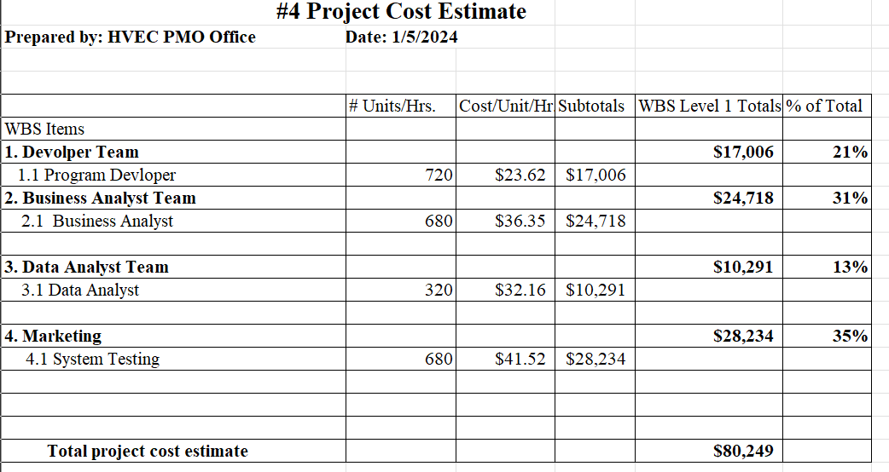
Cost management plan
Notes:
The way the cost management plan was created was through finding the average salaries of the jobs listed above.
We then moved forward by breaking down what we thought the average of each departments total contribution for the project would be by hours. Vicente

Slide 7
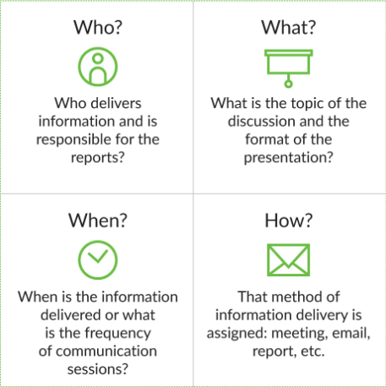
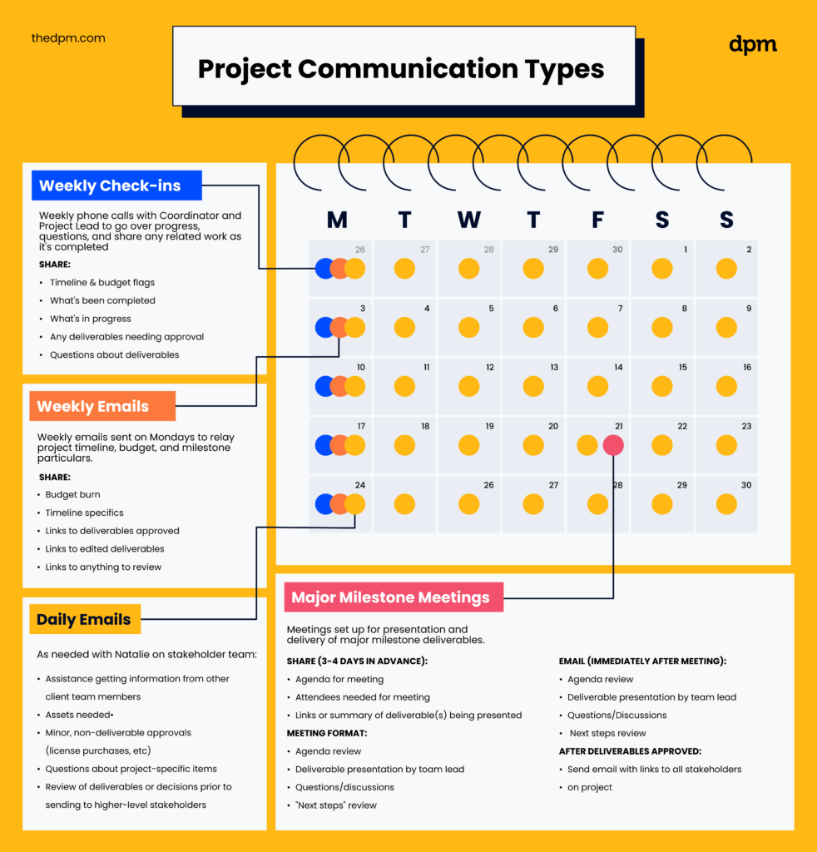
Communication management plan
Notes:
Melvin

Slide 8
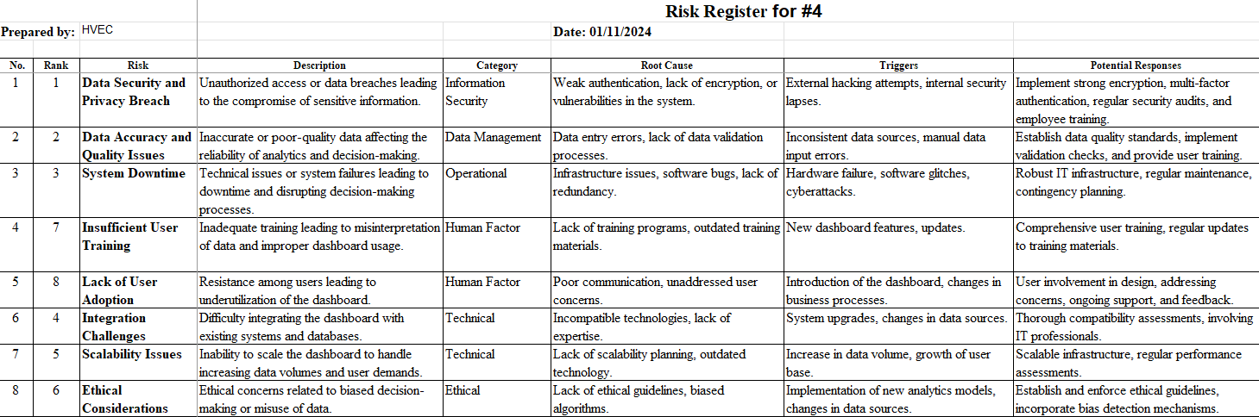
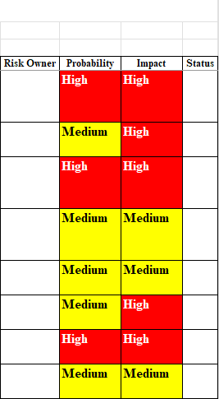
Risk management plan
Notes:
Chandi

Slide 9

Closing -ongoing training and updates -available support in future -Future enhancements -https://mgpjrx.github.io/
Notes:
Chandi

Slide 10
Questions? Thank you

